Slide 1
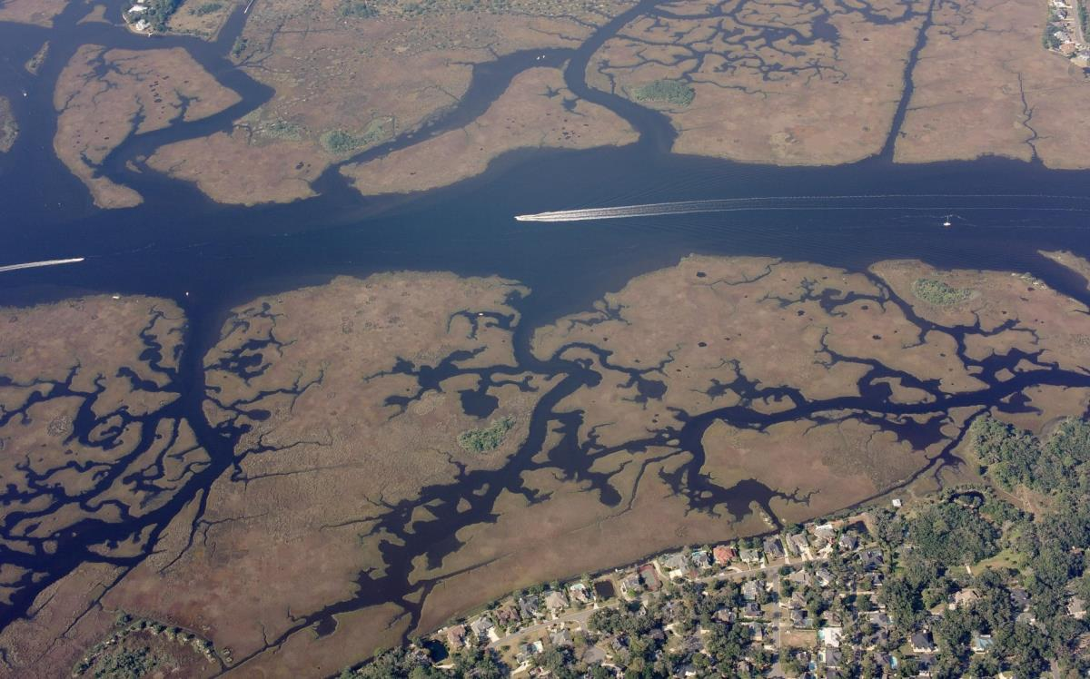
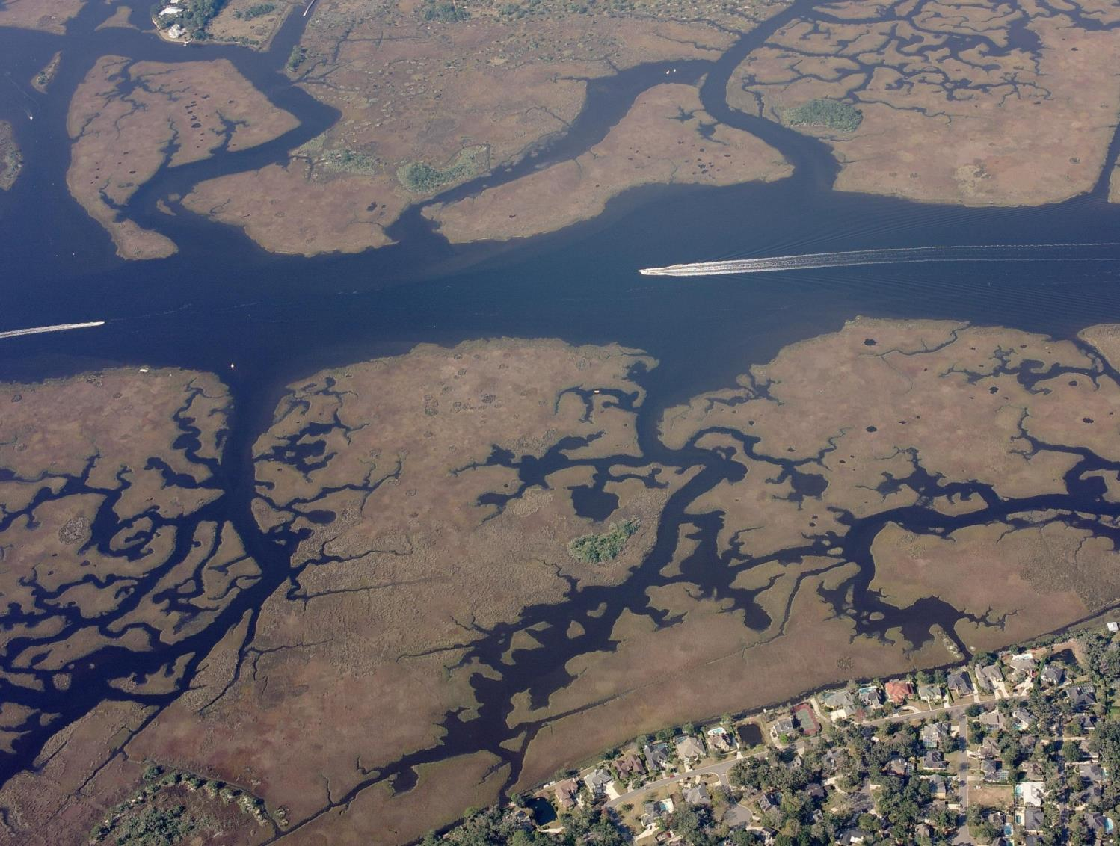
2019 Florida Inland Navigation District Proposed Applications

Slide 2
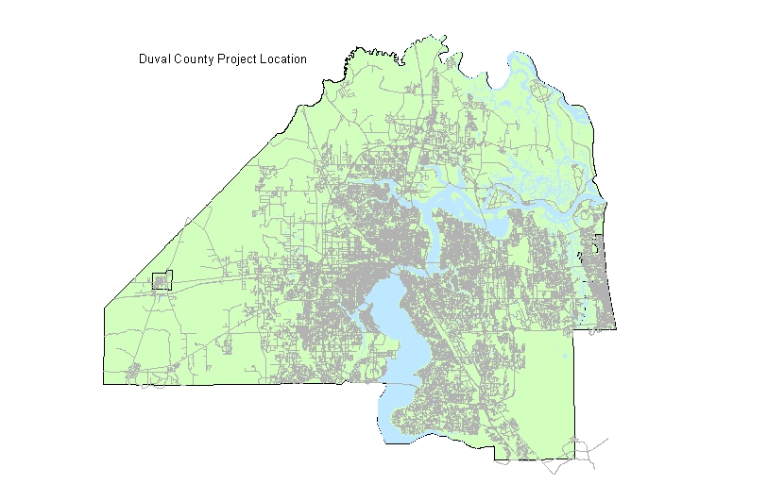
Location of 2019
Proposed FIND Projects
Oak Harbor Dredge
Johnston Island Acquisition
Mandarin Park Dock & Kayak Launch
Design Phase
Construction Phase
Acquisition

Slide 3
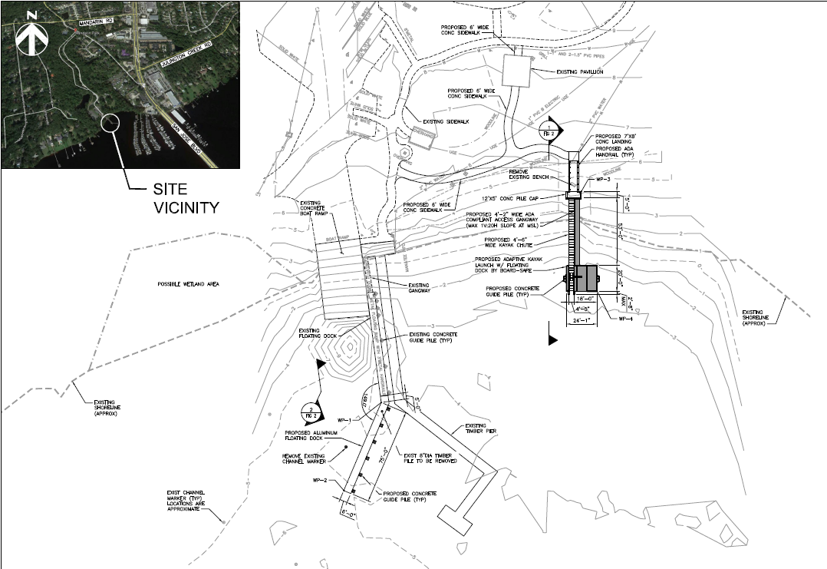
Mandarin Park Boat Ramp
Dock & Adaptive Kayak Launch
Council District 6
Cost: $750,000
Scope: Construct extension of boat ramp dock & install adaptive kayak launch

Slide 4
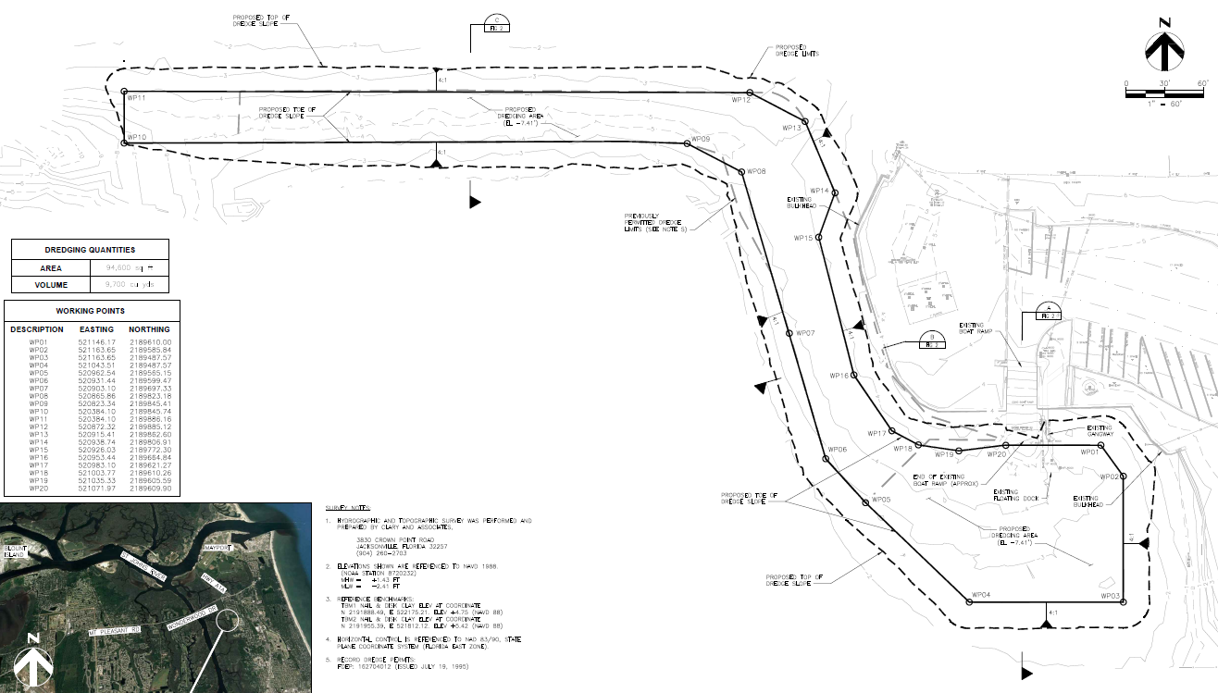
Oak Harbor Boat Ramp Dredge
Council District 13
Cost: $1,600,000
Scope: Implementation of dredge from ramp to channel; approx. 9700 CY

Slide 5
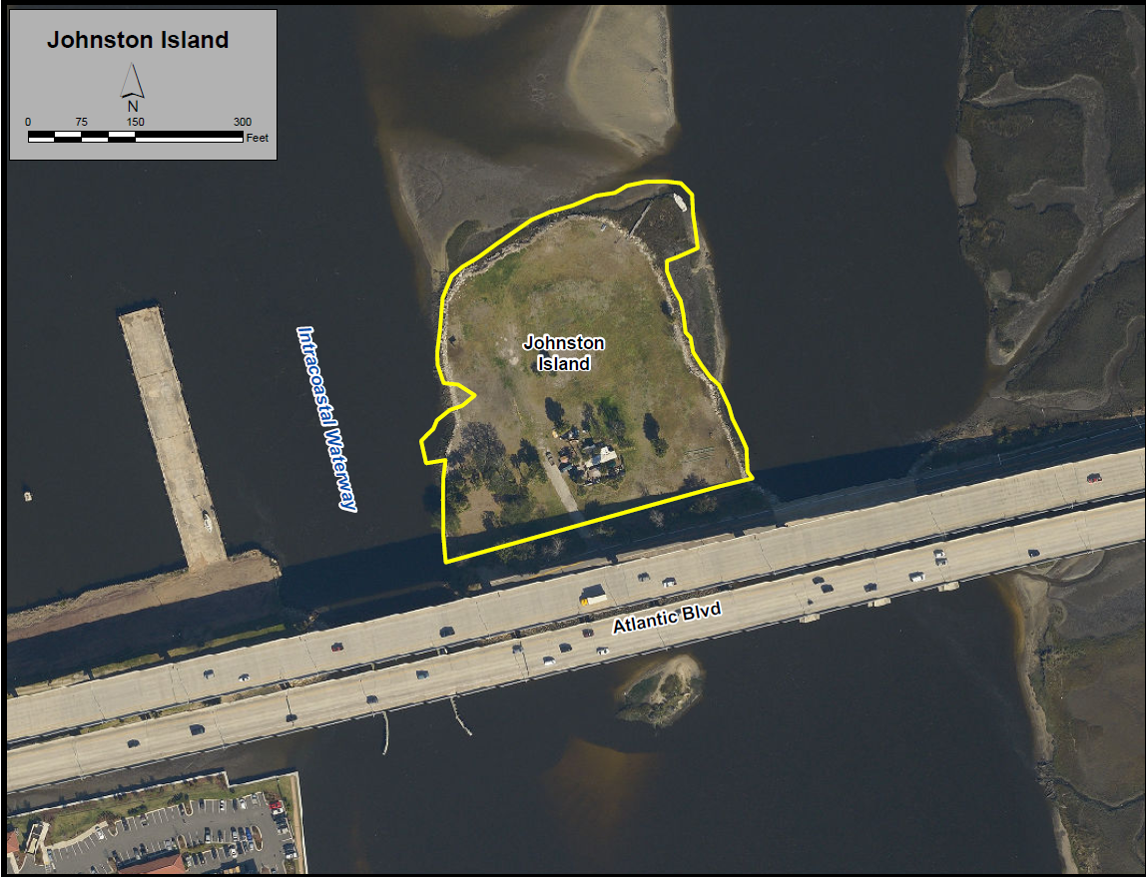
Johnston Island Acquisition
Council District 13
Cost $1,500,000
25% FIND
37.5% COJ
37.5% COAB
Scope: Acquire Johnston Island in ICW under Atlantic Blvd Bridge for future park/boating destination

Slide 6
